Slide 1
Optical Character Recognition using Tesseract
Amr Mohamed Ashour
Hanna Nabil
Mostafa Abo-el Wafa

Slide 2
Brief History Of Tesseract
◆ Open Source OCR engine sponsored by Google since 2006.
◆ One of the most accurate open source OCR engines currently
available.
◆ Originally developed by HP between 1985-1994.
◆ Lot of it is written in C and C++.

Slide 3
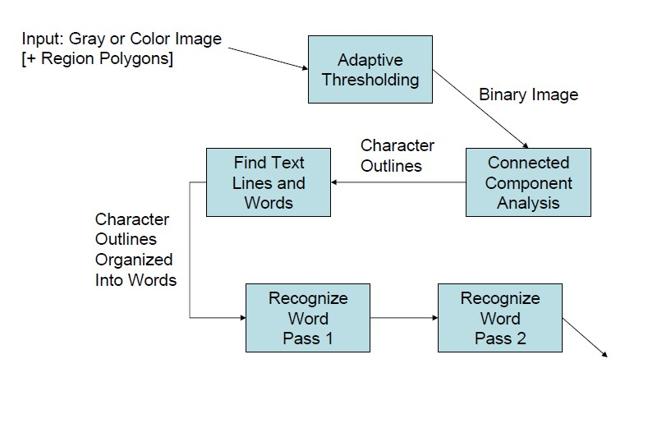
TessOCR Architecture

Slide 4
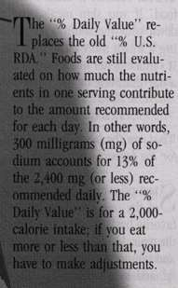


Adaptive Thresholding is Essential

Slide 5

Baselines are rarely perfectly straight

Slide 6


Spaces between words are tricky too
◆ Italics, digits, punctuation all create special-case font-dependent spacing.
◆ Fully justified text in narrow columns can have vastly varying spacing
on different lines.

Slide 7
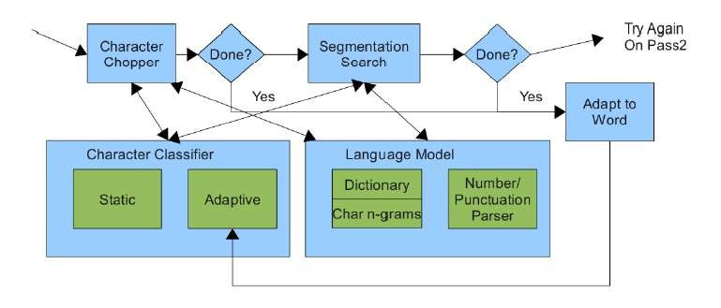
Tesseract Word Recognizer

Slide 8
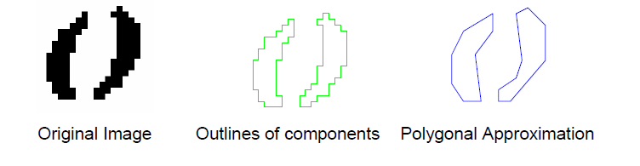
Outline Approximation
◆ Polygonal approximation is a double-edged sword.
◆ Noise and some pertinent information are both lost.

Slide 9
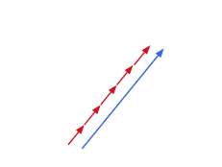
Why it’s called Tesseract?
◆ Elements of the polygonal approximation, clustered within a character/font combination.
◆ x, y position, direction, and length (as a multiple of feature length)
Notes:
(four rays)

Slide 10
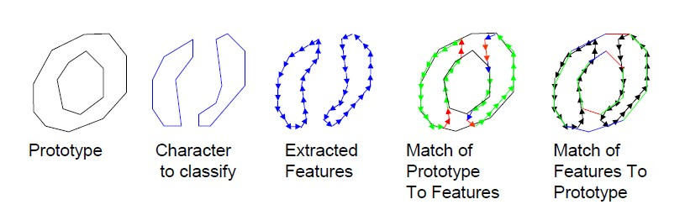
Character Classifier (Features and Matching)
◆ Static classifier uses outline fragments as features. Broken characters are easily recognizable by a small->large matching process in classifier. (This is slow.)
◆ Adaptive classifier uses the same technique!

Slide 11
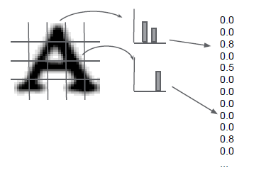
Classifier as Histogram of Gradients
◆ Quantize character area.
◆ Compute gradients within.
◆ Histograms of gradients map to fixed dimension feature vector.

Slide 12
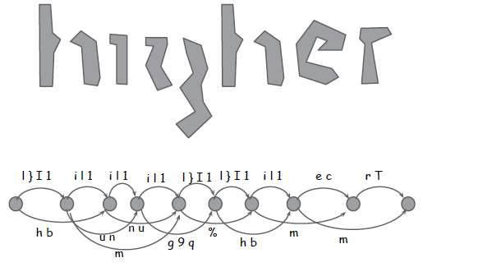
Character Segmentation
◆ Segmentation Graphs

Slide 13
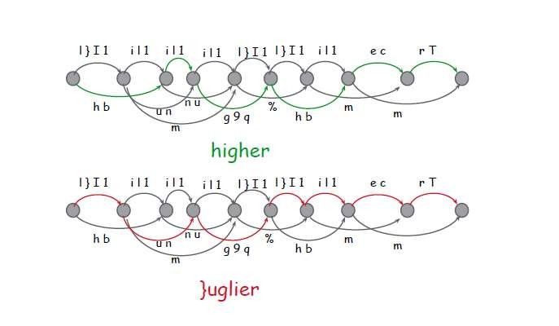

Slide 14
Rating and Certainty
◆ Rating = Distance * Outline length
Total rating over a word (or line if you prefer) is normalized
Different length transcriptions are fairly comparable
◆ Certainty = -20 * Distance
Measures the absolute classification confidence
Surrogate for log probability and is used to decide what needs more work.

Slide 15
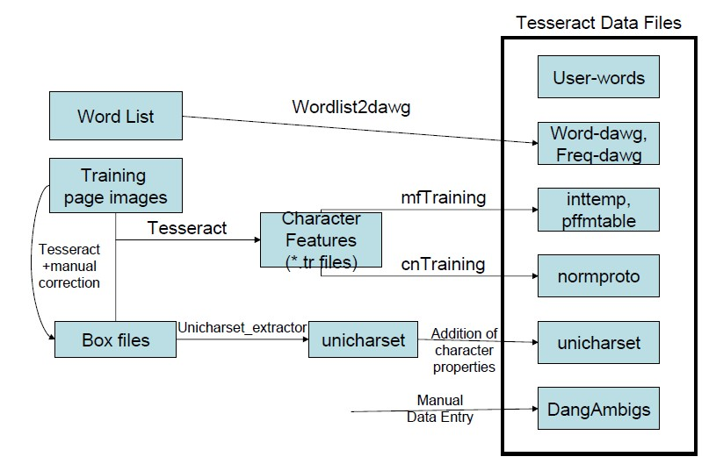
Tesseract Training

Slide 16
Thank You

